Slide 1



Mongo Indexing & Aggregations

Slide 2

Objectives
Explain Indexing, its types, and properties
Describe Index Management
Explain Aggregation and its types
Index Building Process

Slide 3

Objectives
Rebuilding and Measuring Indexes
Aggregation and its Types
Working with MapReduce

Slide 4

Indexing

Slide 5

WHY INDEXING?
Index is a Database Object that can improve the query performance.
It’s a pointer which keeps address of the documents.
It reduces full table/collection scan.
Indexes consume space the way collections or tables consumes. Indexes gets stored in RAM to retrieve the information faster.

Slide 6




WHEN SHOULD INDEX BE CREATED?
When there is huge data in collection
When performing heavy read operation
When using same key frequently
When performing 2% to 4% data retrieval from your collections

Slide 7

When To Avoid Index?
If you have less data.
If you are not using information frequently.
If you need to scan complete table/collection/book.
If your application is heavy write oriented.
If you are performing more DML operations.
If you are performing bulk load.

Slide 8

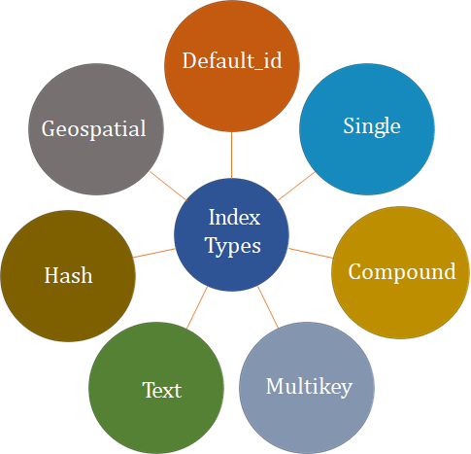
If you are performing bulk load

Slide 9
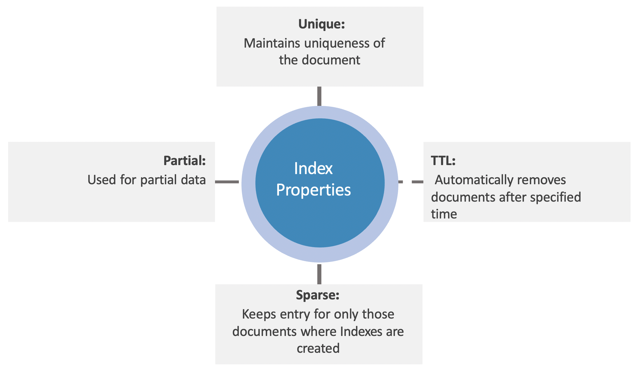
Properties of Indexes

Slide 10
Index Building Process
Uses an incremental approach and is slower than the normal “foreground” process.
1
If you perform any administrative operations when MongoDB is creating indexes in the background for a collection, you will receive an error. The index building process at the background:
Depends on the size of the
index for its speed.
2
Impacts database
performance.
3

Slide 11
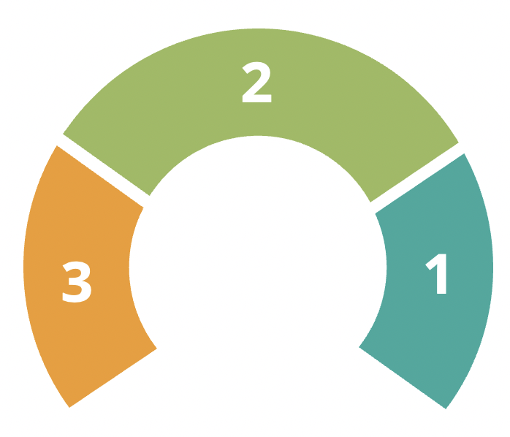
AVOIDING PERFORMANCE ISSUES
Equivalent method for your driver and ensure it terminates an operation if the proper indexes do not exist.
Separate application codes and designated maintenance windows
getIndexes() to ensure that your application checks for the indexes at the start up.

Slide 12
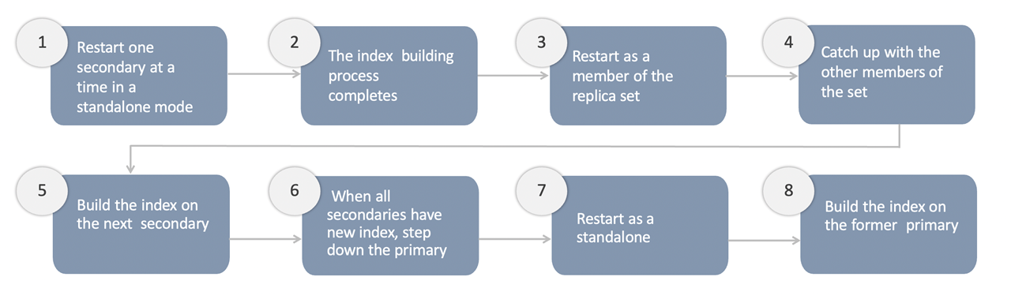
Index Creation On Replica Set

Slide 13

REBUILDING INDEXES
db.collection.reIndex method can be used to rebuild indexes. It drops all indexes including _id and rebuilds all indexes in a single operation.
Commands that can be used when rebuilding indexes:
db.currentOp(): Type this command in the mongo shell to view the indexing process status.
db.killOp(): Type this command in the mongo shell to abort an ongoing index build operation.
1
2

Slide 14
Measuring Index Use
Query performances indicate index usage.
The explain() method is used to print information about query execution. It returns a document that explains the process and indexes used to return a query.
MongoDB provides the following methods to observe index use for your database:
db.collection.explain() or the cursor.explain() helps measure index usages.
1
2

Slide 15
Aggregation

Slide 16
INTRODUCTION TO AGGREGATION
Aggregations process data sets and return calculated results. It is run on the MongoDB instance to simplify application codes and limit resource requirements.

Slide 17
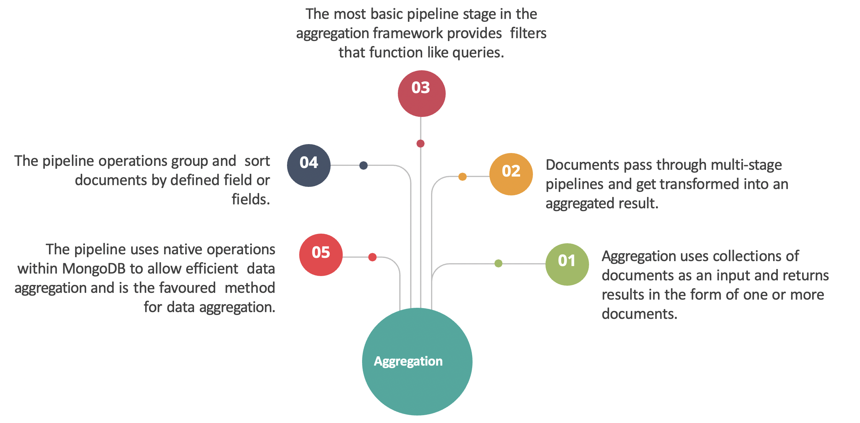
Characteristics Of Aggregation

Slide 18
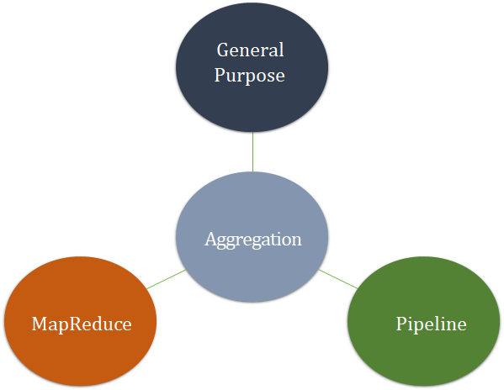
Types Of Aggregation

Slide 19
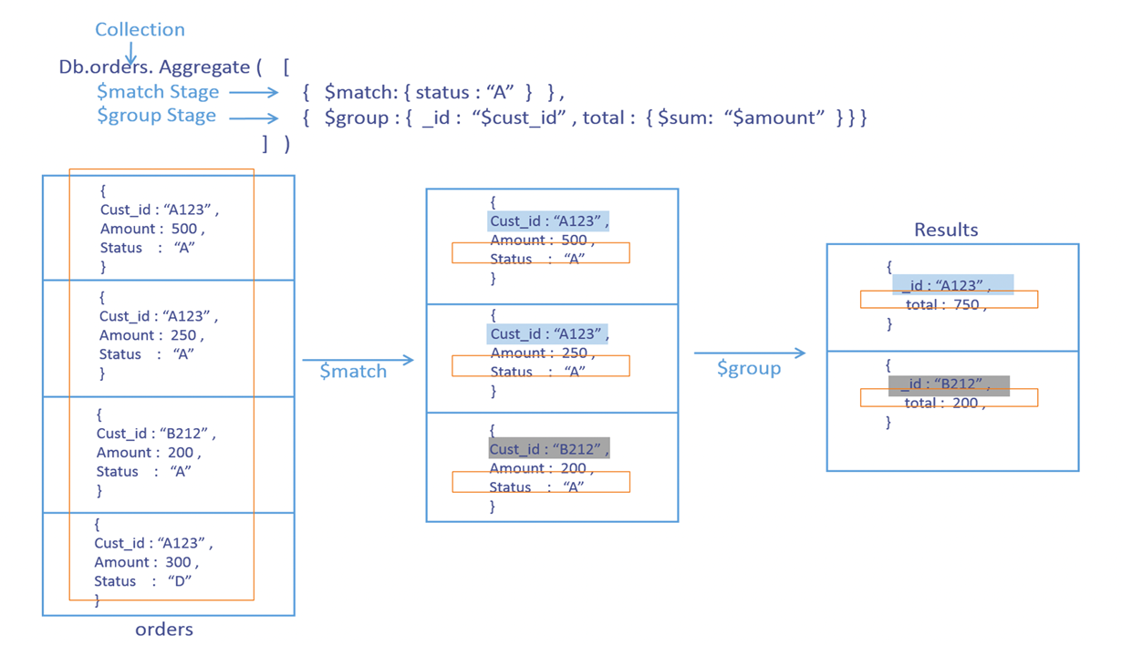

Slide 20
MapReduce
MapReduce is a data processing model used for aggregation. To perform map-reduce operations, MongoDB provides the MapReduce database command.
It is written in JavaScript.
Accept documents as inputs, perform sort and limit functions, and then start the map stage.
MapReduce operations:
Associate values to a key by using the custom JavaScript functions.
1
2

Slide 21
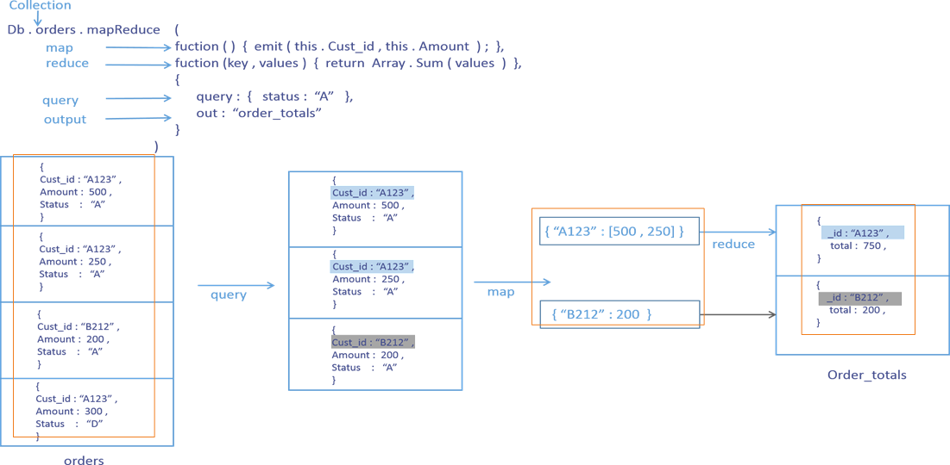
Aggregation Operation Using Mapreduce

Slide 22

Thank you!

